Slide 1

Campus 5s

Slide 2
Team Members
ARJUN PUSHPARAJ-TTC0822060
ATHUL RAJ N-TTC0822021
K VIVEK VARDHAN-NEC0822083
P VARSHITH SAI-NEC0822038
PRADEEP P-NEC0822018

Slide 3
AGENDA
INTRODUCTION
SRS(SOFTWARE REQUIREMENT SPECIFICATIONS)
FEASIBILITY STUDY
EXISTING SYSTEM WITH DISADVANTAGES
PROPOSED SYSTEM WITH ADVANTAGES
MODULES AND FUNCTIONALITIES
DATA FLOW DIAGRAM(DFD)
DATABASE DESIGN
ER DIAGRAM
GANTT CHART
CONCLUSION

Slide 4
Introduction
This project demonstrates how technology can optimize campus management, fostering a more organized and productive learning environment. We hope you find our platform easy to use and insightful!
Administrators can track, audit, and manage campus zone cleanliness, organization, and efficiency in real-time, helping institutions maintain a well-kept environment in line with 5S standards.

Slide 5
SRS
(software requirement specifications)

Slide 6
SRS
Frontend
Technologies: HTML, Tailwind CSS , java script
Features:
Responsive UI (Mobile & Desktop)
Interactive components (Navbars, Modals, Tables, Buttons)
Tailwind utility classes for styling
Backend
Technologies: Django
Features:
User Authentication & Role Management
API Development (Django Rest Framework)
Business Logic for Zone, Asset, and Performance Management

Slide 7
SRS
Database
Technology: MongoDB
Features:
Collections for Users, Zones, Audits, Assets, Feedback
Scalable and flexible schema
Indexed queries for performance
Deployment
Tools: Docker, Cloud (AWS/Heroku)
Static Hosting: Use CDN for frontend assets
Database Hosting: MongoDB Atlas

Slide 8
Hardware Requirements

Slide 9
Hardware Requirements
Server Requirements:
Processor: Minimum 2.5 GHz Quad-Core, Recommended 3.0 GHz Octa-Core
RAM: Minimum 8 GB, Recommended 16 GB
Storage: 100 GB SSD
Network: 1 Gbps internet connection
Database Server:
Processor: 2.5 GHz Quad-Core
RAM: 8 GB Minimum
Storage: 50 GB SSD (expandable)
Client Devices:
Desktop/Laptop: Windows 10 or MacOS (latest versions)
Mobile: Android 8.0+ or iOS 12+
Browsers: Latest versions of Chrome, Firefox, Safari, Edge

Slide 10


Slide 11
Feasibility Study
Technical Feasibility
Platform Design and Architecture: The Campus 5S web app will use modern technologies like HTML, CSS, JavaScript (React), and back-end frameworks (Node.js). A secure database (e.g., MySQL, MongoDB) will store campus zone, audit, and 5S data, accessible on desktop and mobile for real-time updates.
Scalability and Maintenance:The platform is scalable for large or multi-campus institutions, with regular updates and bug fixes for smooth operation.

Slide 12
Feasibility Study
2. Operational Feasibility
Ease of Use: The platform will be user-friendly with an intuitive interface. Administrators and staff can easily track, audit, and manage campus zones, minimizing the learning curve.
Staffing and Workflow Changes: The Campus 5S platform requires minimal workflow changes, with training and automated reports to reduce manual auditing.
Impact on Campus Management: The platform will streamline campus operations by providing real-time data on zone management and ensuring adherence to 5S principles

Slide 13
Feasibility Study
3. Financial Feasibility
Cost of Development and Implementation: The initial cost for the Campus 5S platform includes development, design, and testing, with ongoing costs for hosting, maintenance, and support. These should be weighed against savings from reduced manual audits and improved zone management.
Cost-Benefit Analysis: The application will save educational institutions by improving efficiency, reducing audit time, enhancing campus organization, and lowering maintenance costs.

Slide 14
Feasibility Study
4. Social Feasibility
Stakeholder Acceptance: Campus administrators and staff are likely to appreciate the benefits of the platform, particularly in terms of ease of use and improved efficiency in campus management. The platform is designed to be intuitive and easy to integrate into existing workflows.

Slide 15
Existing Systems
(Areas Used In)

Slide 16
Existing Systems (Areas used in)
CAMPUS ENVIRONMENT : to enhance organization, cleanliness, and overall efficiency.
HEALTHCARE : Hospitals use 5S to organize supplies, equipment, and records, ensuring cleanliness, order, and safety in high-stress environments.
OFFICE ENVIRONMENT: Offices use 5S to organize files, workstations, and digital resources, improving collaboration and workflow efficiency.

Slide 17
Existing Systems (Areas Used In)
Disadvantages of Existing System:
Time-Consuming: Manually auditing 5S with Excel is time-consuming, especially for large organizations or campuses with multiple departments and items to track.
Difficulty in Tracking Progress: Excel is not ideal for tracking 5S progress over time, making it difficult to monitor trends or changes without complex formulas and manual updates.
Data Security and Integrity Issues: Excel lacks strong data security and version control, risking unauthorized access, data loss, or corruption.

Slide 18
Existing Systems (Areas Used In)
Limited reporting and analytics: Excel's reporting features are limited, making it less suitable for generating reports or detailed 5S audit analysis compared to dedicated software.
Difficulty in Identifying Patterns and Trend: Manual auditing in Excel makes it difficult to identify patterns and trends in 5S, requiring advanced analytics or AI tools that Excel cannot provide without complex setups.

Slide 19
Proposed System (Advantages)

Slide 20
Advantages
Integration of Software : A centralized platform for managing 5S tasks, integrating software tools for efficient inventory tracking.
Real-Time Updates: A live dashboard provides real-time task tracking, updates on audit findings, and keeps stakeholders informed, improving coordination and reducing delays.
Improved Accountability: The platform assigns tasks with deadlines and logs task history and user actions for traceability

Slide 21
Advantages
Eco-Friendly and Sustainable: The platform minimizes paperwork by digitizing processes and promotes a greener campus culture through the adoption of digital tools.
Scalability: The platform expands to accommodate campus growth and future-proofs the system for emerging technologies and evolving needs.

Slide 22
Modules

Slide 23
Modules
User Management Module: User registration
Zone Management Module: Managing zones.
Red Tag Management Module: Assigning red tags.
Audit Management Module: Schedule and conduct audits.
Performance Analytics Module: Monthly performance tracking
Asset Management Module: Maintenance history
Documentation Module: Photo upload management
Rating System Module: Define rating criteria
Notification Management Module: View notifications.
Cell Management Module: Manage cells and view cell information

Slide 24
Functionalities

Slide 25
Functionalities:
User Management Module :-
User profile creation and updates
Manage user roles and permissions
Password management and recovery
View user activity logs

Slide 26
Functionalities:
Zone Management Module:-
Create, update, and delete zones
Assign users and assets to zones
View comprehensive zone details
Track zone performance metrics
Generate zone-specific reports

Slide 27
Functionalities:
Red Tag Management Module:-
Flag critical items or areas.
Track and resolve tagged issues
Manage red tag history and logs
Generate reports on red tag resolutions

Slide 28
Functionalities:
Audit Management Module:
Define audit schedules and criteria.
Conduct and log audits with real-time updates
Generate detailed audit reports
Assign and track corrective actions

Slide 29
Functionalities:
Performance Analytics Module:
Monthly performance score tracking
Generate performance reports
Visualize data through dashboards
Custom report generation
Zone-wise performance comparison

Slide 30
Functionalities:
Asset Management Module:-
Track and update asset details.
Log maintenance and repair history
Manage asset lifecycle from acquisition to disposal
Assign assets to zones or users

Slide 31
Functionalities:
Documentation Module:-
Upload, store, and organize documents.
Manage photo attachments for audits, assets, or feedback
Search and retrieve stored files easily
Secure sensitive documents with access controls

Slide 32
Functionalities:
Rating System Module:-
Establish and modify rating criteria.
Apply ratings to users, assets, or zones.
Track and analyze rating trends.
Generate rating-based performance reports

Slide 33
Functionalities:
Notification Management Module:-
Configure and manage notification preferences
View and filter notifications by type or priority
Set alerts for critical updates or tasks
Archive older notifications for reference

Slide 34
Functionalities:
Cell Management Module:-
Create, update, and delete cells
Assign resources or users to cells
View and manage cell-specific details
Generate cell performance reports

Slide 35
DATA FLOW DIAGRAM(DFD)

Slide 36
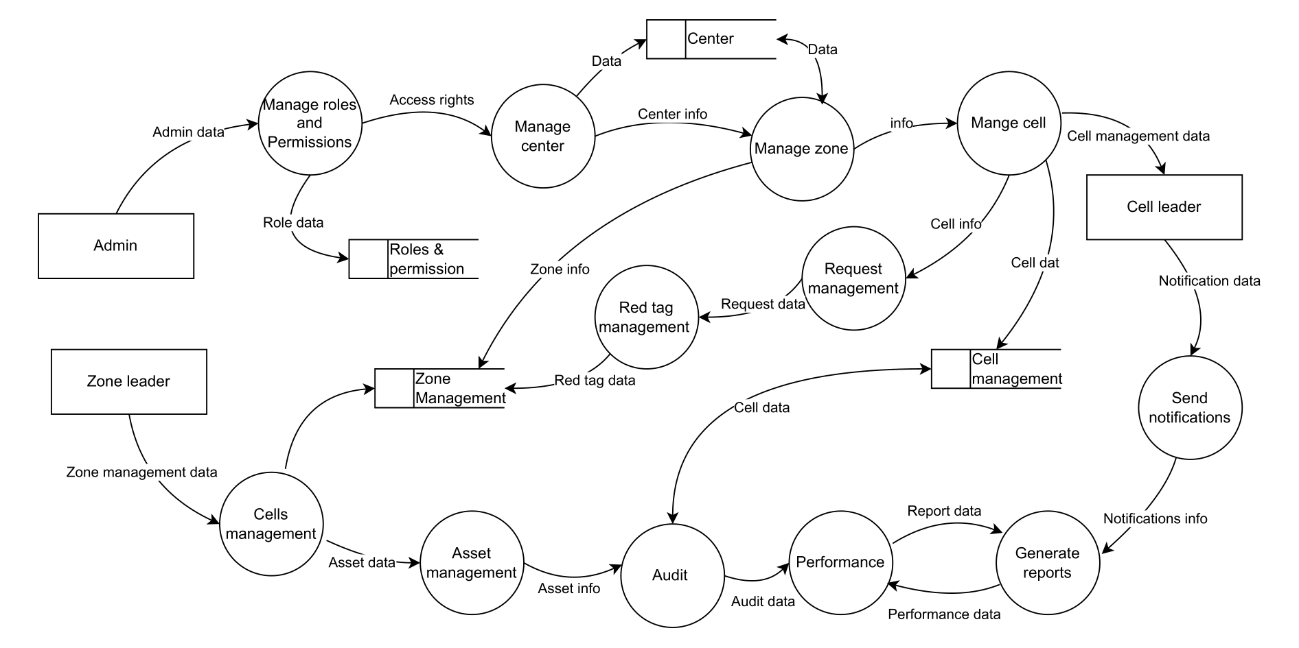
DFD

Slide 37
DATABASE DESIGN

Slide 38
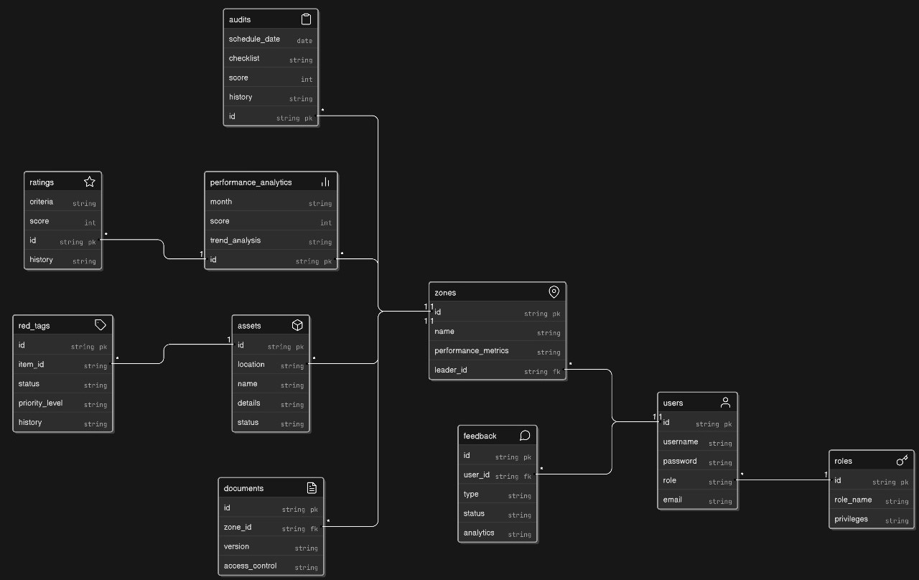
DATABASE DESIGN

Slide 39
ER DIAGRAM

Slide 40
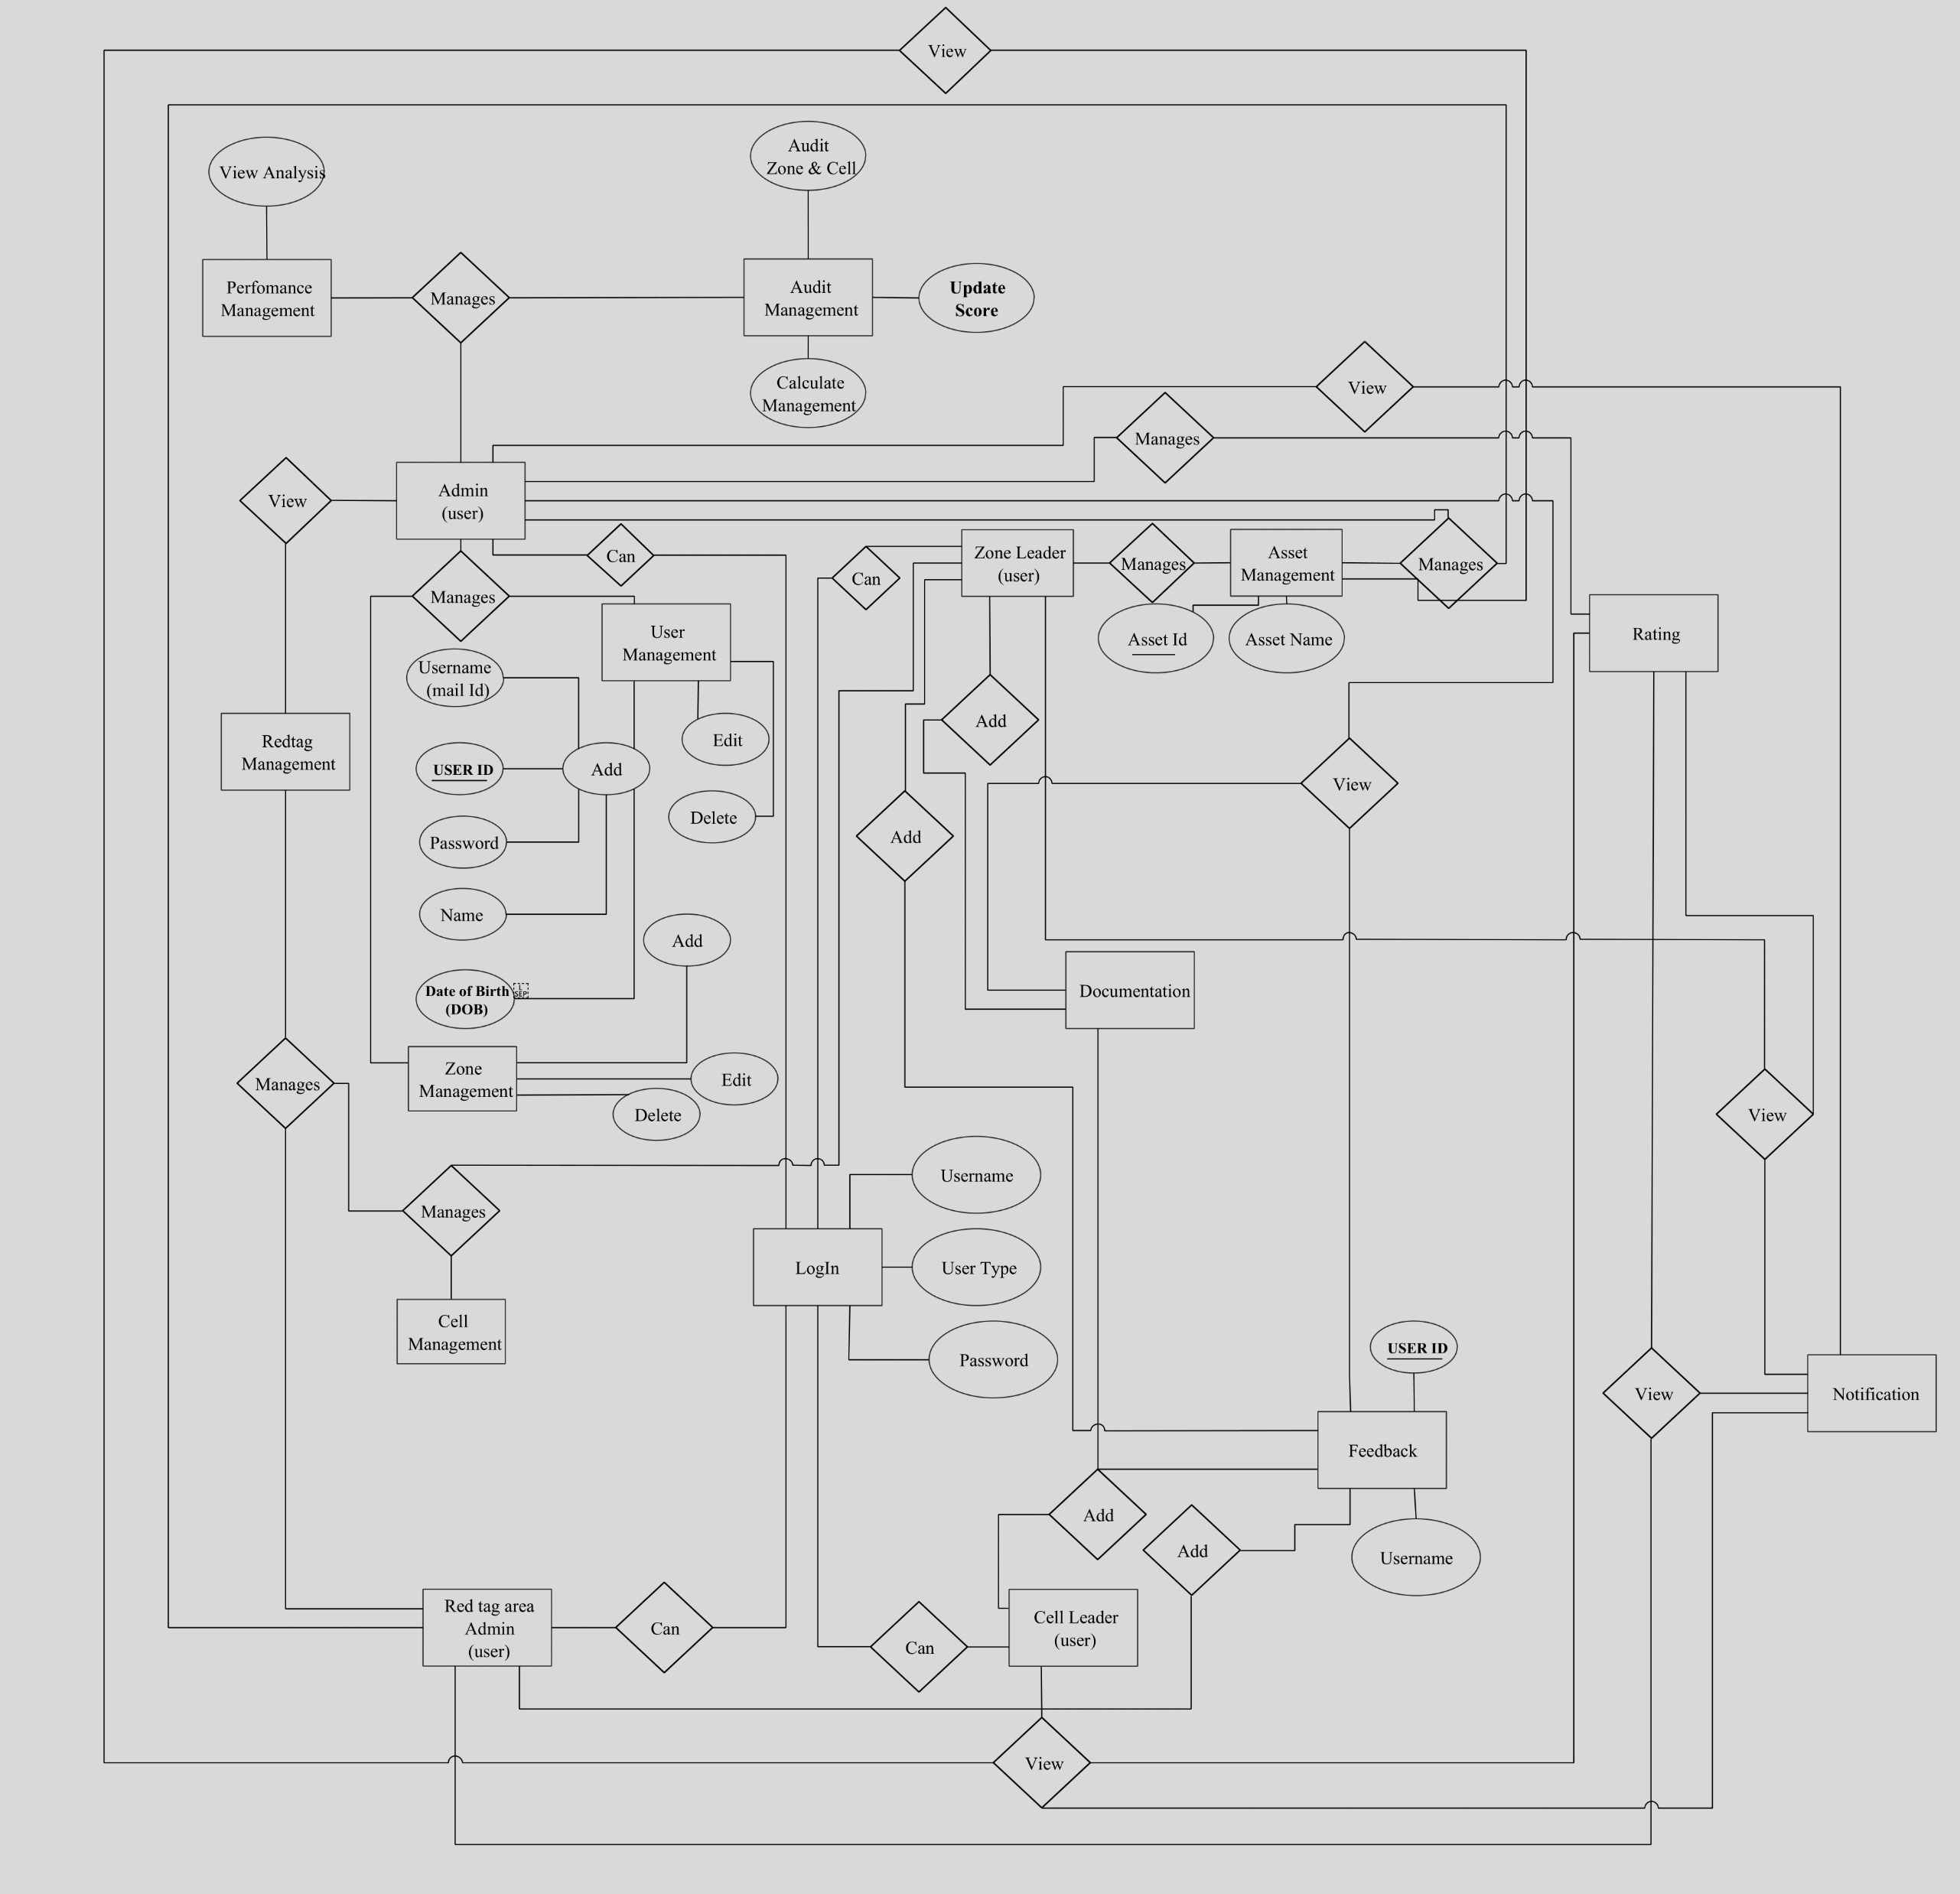
ER DIAGRAM

Slide 41
GANTT CHART

Slide 42
GANTT CHART
Time Alloted / Task | January | February | March | April | May | June
Requirement Gathering
Plan & Analysis
Database Setup / Design
Coding
Build
Testing
Implementation
Completed
In Progress
Yet to Start

Slide 43
CONCLUSION

Slide 44
CONCLUSION
The Campus 5S Web Application offers an innovative solution for implementing the 5S methodology, ensuring a cleaner, safer, and more organized campus with centralized data, real-time monitoring, and long-term sustainability to support a more efficient campus

